Slide 1

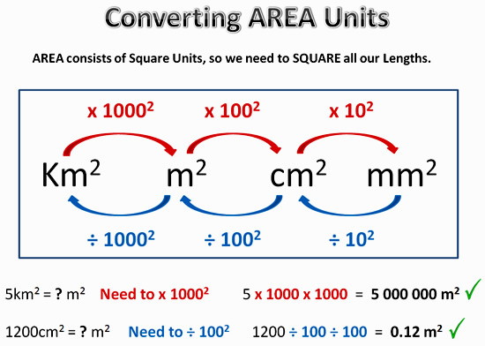
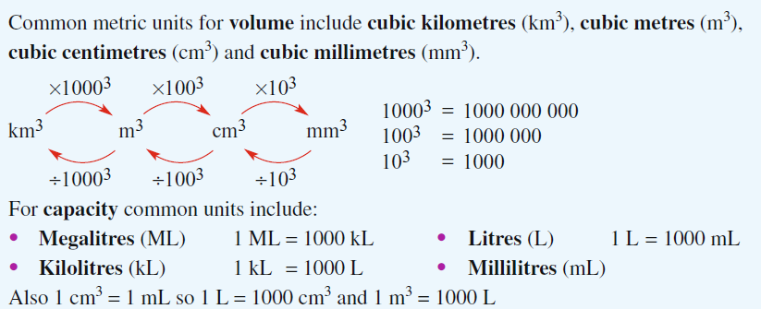
My Measurement Interactive Notebook
Name
Class
Teacher
Term

Slide 2
Contents
Glossary or Formula Page
Page
Date
Description
2

Slide 3
Tasks
24
7
30
Essential Question
Questions
Notes
Summary
6

Slide 4
24
7
30
Date
Total Surface Area
EQ – Describe how to find the Total Surface Area of different shapes.
Summary of formulae in this section
How do we find the Total Surface Area (TSA) of 3 dimensional shapes?
Shape | TSA Formula
Prisms | TSA = total area of all faces Rectangular Prism: 6 faces (if closed) Triangular Prism: 5 faces (if closed)
Cylinders | TSA = 2 π r h (for the curved wall) + π r² for each circular end if there is one
Spheres | TSA = 4 π r²
Cones | TSA = π r L (for the curved wall) + π r² for the circular base if there is one
Pyramids | TSA = Base area + area of the triangular sides.These can be tricky – you may need Pythag to work out height of sloping faces!
May need Pythag to find L
All Areas are in Square units – m². cm², mm²
Because Volume is 2 – DIMENSIONAL!

Slide 5
2.1: TSA of a rectangular prism or cube
6m
7m
8m
How do we find the Total Surface Area (TSA) of a rectangular prism or cube?
Cut the box up into its 6 faces
Front & Back.
8m
6m
2 of these, so SA
= 2 × 8 × 6 = 96 m²
8m
Top & Bottom.
7m
2 of these, so SA
= 2 × 8 × 7 = 112 m²
7m
6m
Left & right.
2 of these, so SA
= 2 × 6 × 7 = 84m²
TSA = 96 + 112 + 84 = 292m²

Slide 6
TSA of a Cylinder
3 types
r
How do we find the Total Surface Area (TSA) of a cylinder?
h
Nº 1
Nº 2
Nº 3
h
Closed both ends –
3 surfaces
Closed one end –
2 surfaces
Open both ends –
1 surface
1 curved wall
2 circles
1 curved wall
1 circle
The curved wall only

Slide 7
Finding the formula for the area of curved wall
r
C=2πr
r
h
How do we find the Total Surface Area (TSA) of a cylinder?
h

Cut it up the side. The red circumference (2πr) above becomes the red length below
Begin with an open-ended cylinder
2πr
h
Area = 2πrh

Slide 8
Example – find the surface area of this cylinder closed at one end....
3 cm
How do we find the Total Surface Area (TSA) of a cylinder?
We have two areas...
8 cm
Base
Curved wall
A = π r²
A = 2πrh
= π × 3²
= 2π × 3 × 8
If you have closed at both ends just double the base
= 150.80 cm²
= 28.27 cm²
Total = 28.27 + 150.80 = 179.07cm²

Slide 9
TSA of a Cone
2 types
How do we find the Total Surface Area (TSA) of a cone?
Closed cone
Open cone
2 surfaces
1 surface
Curved wall +
Base
Curved wall
Only

Slide 10
Cones - formulae
L
How do we find the Total Surface Area (TSA) of a cone?
r
Area of the curved wall = π r L
L is called “slant height”

Slide 11
Example – find the surface area of this closed cone
9 cm
How do we find the Total Surface Area (TSA) of a cone?
Two areas:
4cm
Circular base
Curved wall
A = π r²
A = π r L
= π × 4²
= π × 4 × 9
= 50.265 cm²
= 113.097 cm²
TSA = 50.265 + 113.097 = 163.362 cm²

Slide 12
Refresher – Pythagoras’s Rule
c² = a² + b² if you want the longest side
c
a
How do we find the Total Surface Area (TSA) of a cone?
OR...
b
b² = c² – a² if you want one of the two shorter sides
Example…..
4 m
Finding the longest side so use the top formula
3 m
x² = 3² + 4²
x m
x² = 25
x = 5

Slide 13
Another cone example. Find the TSA of this open cone
TSA = π r L
Note – we have a problem as we don’t know the slant height L
=13
L
12cm
How do we find the Total Surface Area (TSA) of a cone?
But we DO have a right angled triangle made by L, 5 and 12!!
5cm
Pythag!
L² = 5² + 12²
L² = 169
L = 13 cm
TSA = π r L = π × 5 × 13 = 204.2 cm²

Slide 14
2.4: TSA of a Sphere
r
How do we find the Total Surface Area (TSA) of a Sphere?
TSA = 4 π r²
Example
TSA = 4πr²
Note r = 5
= 4π × 5²
10cm
= 314.16 cm²

Slide 15
TSA of a Pyramid
How do we find the Total Surface Area (TSA) of a Pyramid?
Rectangular-based pyramids (closed) have five faces:
(1) a base – only one of these!
(2) a front & back triangular side (same size)
(3) a left & right triangular side (same size)
If it’s a square based pyramid, all 4 sides are the same size!

Slide 16
Find TSA of this closed pyramid
Perp ht from centre of base is 12cm
Square base of side 10cm
How do we find the Total Surface Area (TSA) of a Pyramid?
Perp ht. of each of the 4 sloping triangles is 13cm (this is actually a sloping length)
12cm
13cm
10cm
10cm
BASE:
10 × 10 = 100 cm²
EACH Δ:
½ 10 × 13 = 65 cm² (4 of these remember)
TSA:
100 + (4 × 65) = 360 cm²

Slide 17
Example 2 – (Extension). Find the TSA of this pyramid
A
3
How do we find the Total Surface Area (TSA) of a Pyramid?
B
C
G
6
E
8
D
5 surfaces:
(1) : Floor is 8 x 6 = 48 (easy!)
(2 & 3) : Right and left Δs ADC and ABE.
(4 & 5) : Front and back Δs ADE and ACB.
First let’s work out the area of triangle ADC (which will be the same as the one opposite it – ABE). We know its base is 6, but its perp. Height AG we have to find – you will have to use pythag!! And similarly with sides 4 & 5 !

Slide 18
24
7
30
Date
Total Surface Area
EQ – Describe how to find the Total Surface Area of different shapes.
How do we find the Total Surface Area (TSA) of a rectangular prism or cube?
Do exercise 3.2 TSA page 35 Dwyer book

Slide 19
Notes Review
24, 7 ,30
Date
Title
Essential question
Notes complete
Notes complete with colour and diagrams
Questions completed
Contents page filed in
Formula page filled in

Slide 20
Homework
Review your notes and write a summary answering the essential question.

